Slide 1
22F_CST2106 - Data Visualization Topics
Final Project Presentation
Topic : Growth of World Population and Future Prediction
Alin Mary Varghese
Oluwatomiloba Omoloba Sarah
Ozal Ganatra
Wali Hyder
December 5th ,2022

Slide 2
Contents
Executive Summary
Problem Statements
Map
Top 20 Countries
Bottom 20 Countries
Deaths by Gender
Comparison between Births & Deaths
Death Rates & Life Expectancy by Gender
Dashboard
Migration
Prediction –2030 ,2040 & 2050

Slide 3
Executive Summary
A qualitative and quantitative analysis has been made to find interesting insights with an attempt to predict the future population.
Following a decade of rapid population growth, there has often been a concern that population growth is out-of-control, and an end to the growth is not in sight. However, with the help of this report we can quite confidently conclude that despite of the fact the Global population continues to grow, the pace or the growth rate is slowing down.
The interactive tool used for the dataset munging and preparation prior to analysis and final data visualizations is Microsoft PowerBI 2022 Desktop.
Factors that have led to Population Growth:
Growth rates
Birthrates
Deathrates
Literacy
Healthcare
Migration
Employment

Slide 4
With the analysis we can say that despite of the fact the Global population continues to grow, the pace or the growth rate is slowing down.
DATA SOURCE
The basis of the report and analysis is majorly from the United Nations Department of Economic and Social Affairs, Population Division - World Population Prospects 2022 Dataset (File GEN/01/REV1) [1].
SCOPE
The base year taken into consideration for this study and the visualizations is 1950 for a period ranging over 100 years. Hence The scope is from 1st January 1950 to 1st January 2021 and predictions have been done for 2030, 2040 until 2050.
When depicting countries only twenty are shown for a couple of reasons, one of which is because presently around 70% of the world’s population reside in the top twenty most populous countries. Another reason is that it is broad enough to convey the necessary information, also preventing visualizations from being too cluttered.

Slide 5

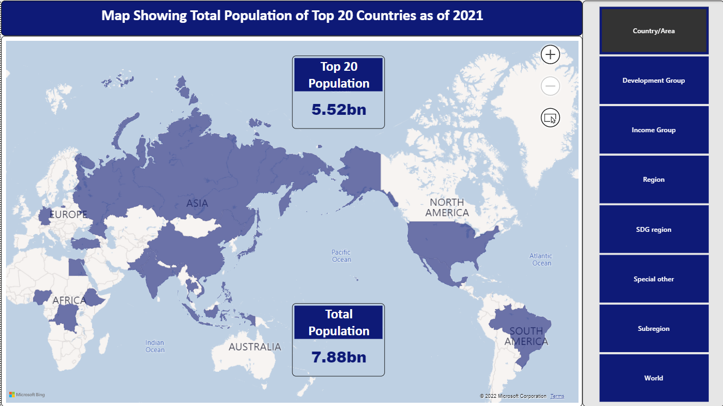
Notes:
52

Slide 6
Problem Statements
What are the main factors that are affecting population growth?
Determine the future prediction of the population for the years 2030, 2040 and 2050 based on the current data.

Slide 7
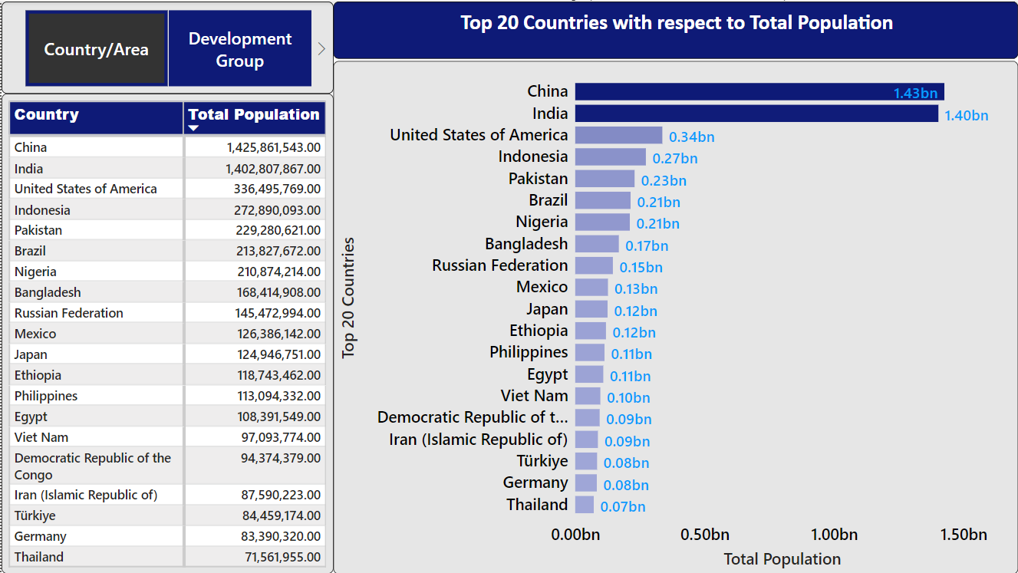

Slide 8
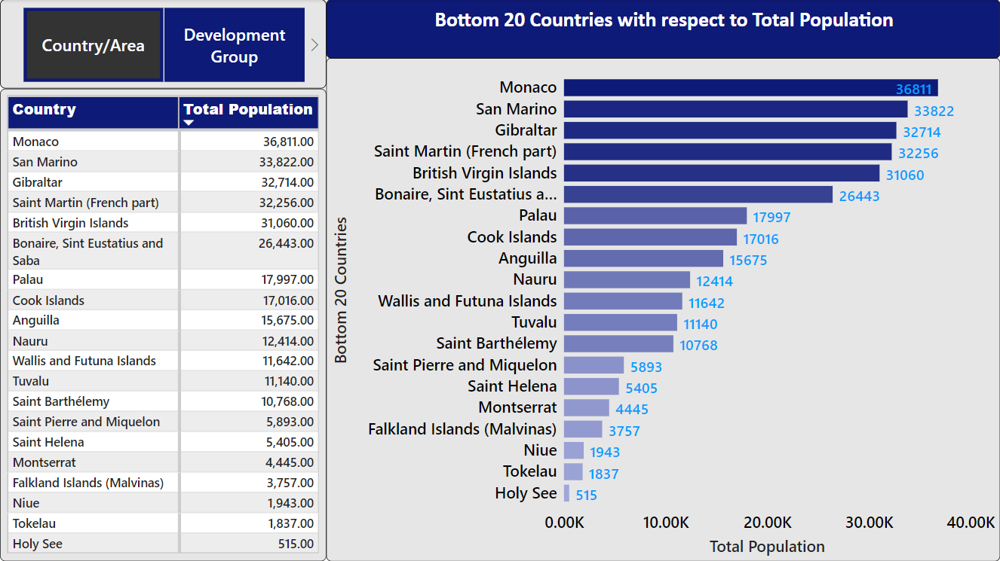

Slide 9
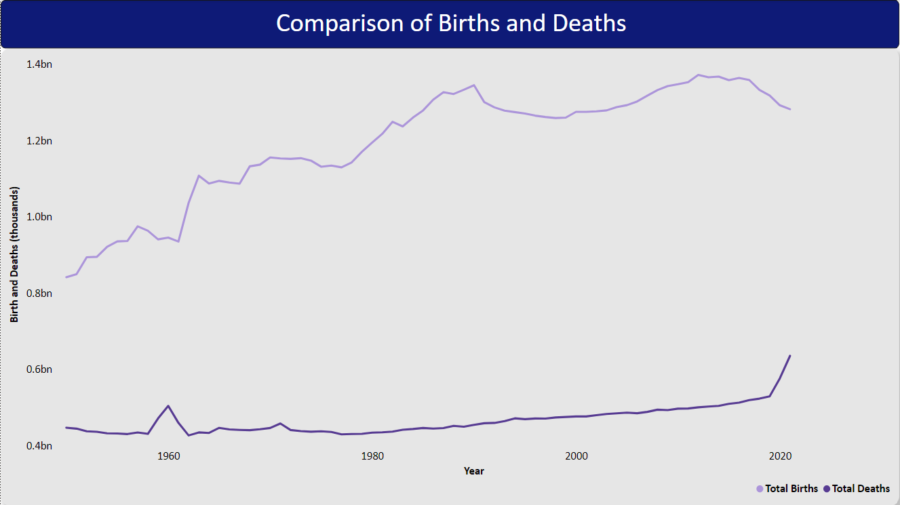
The global population is seeing a decrease in birth rate and an increase in death rate.
At some point the birth rate and the death rate will intersect surpass the other - 2086
“UN data released in 2018 states that around 250 babies are born every minute across the world” [2].

Slide 10
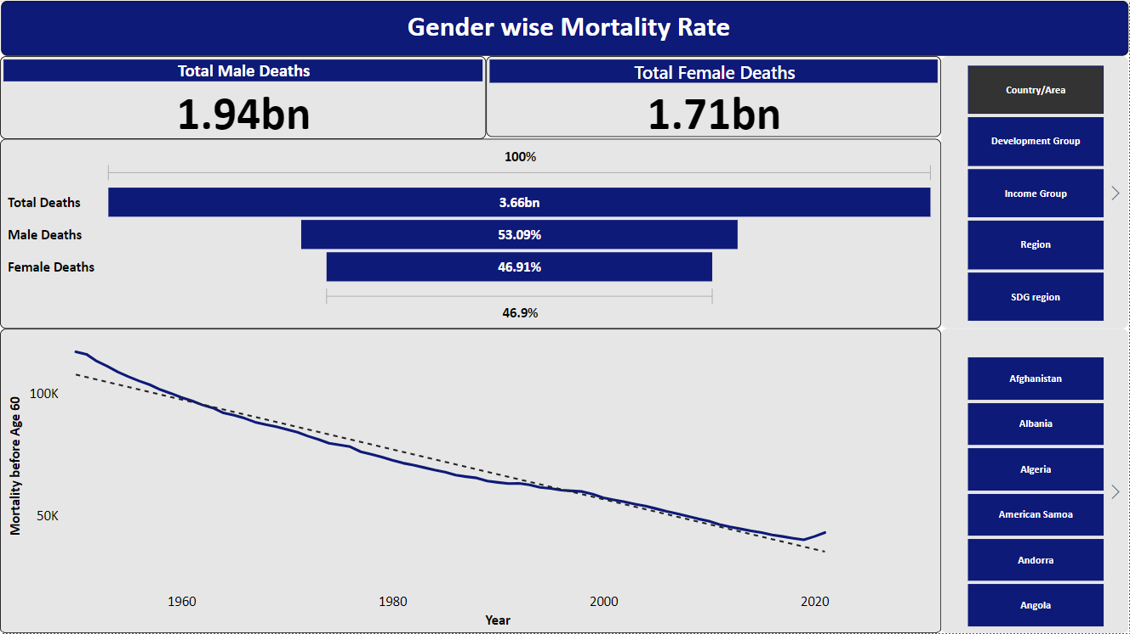

Slide 11
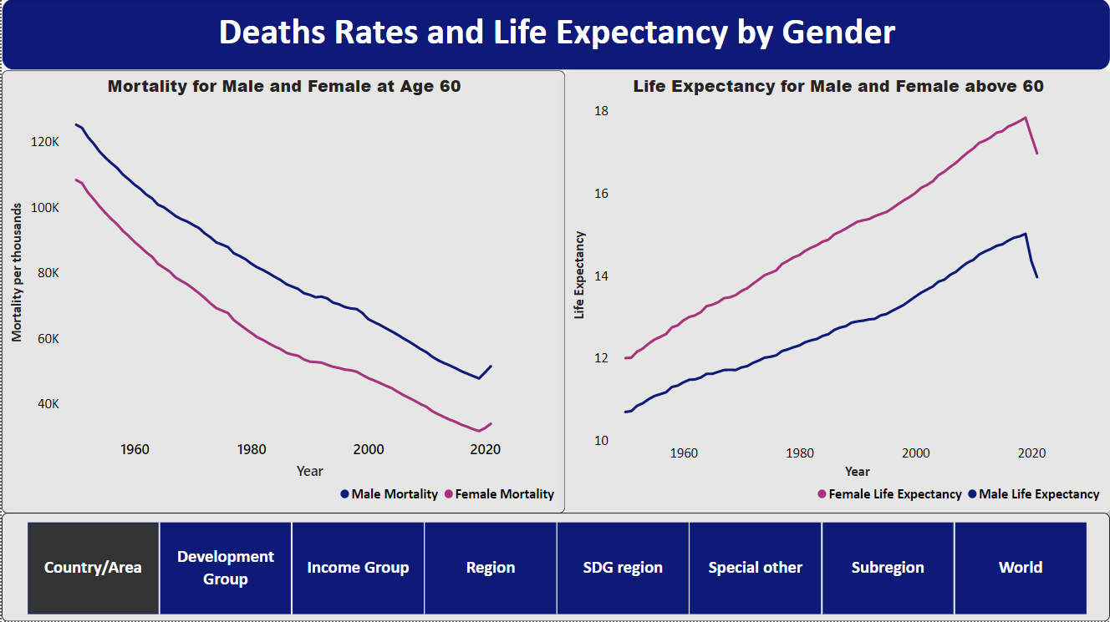
Males have a higher death rate and a lower life expectancy rate than women.
The overall mortality rate is dropping and life expectancy rate increasing for the population.
As health is rapidly improving around the world, life expectancy is also increasing rapidly

Slide 12
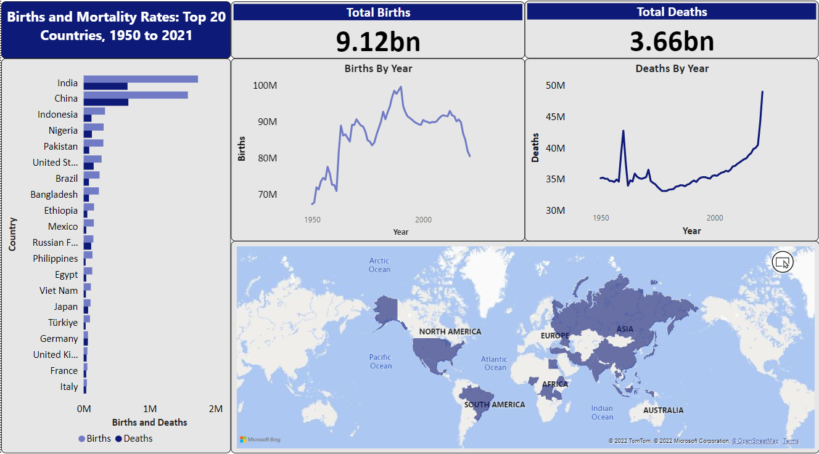
90 billion to 110 billion people have been born from the dawn of humanity till now [3]
The world’s current population is the highest, it has ever been at any given time.
From 1950 till date countries in the top 20 range have seen their total birth rate drop and death rate rise

Slide 13
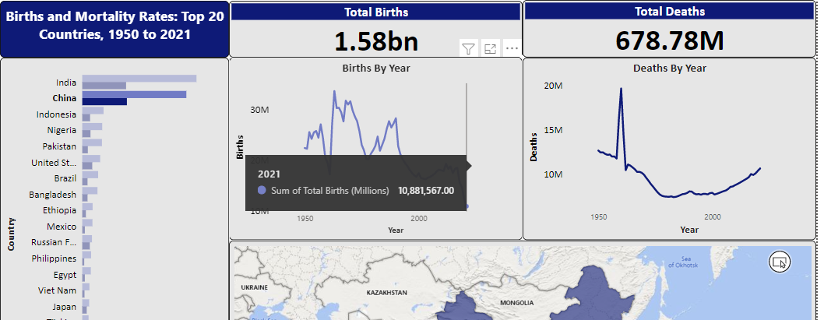
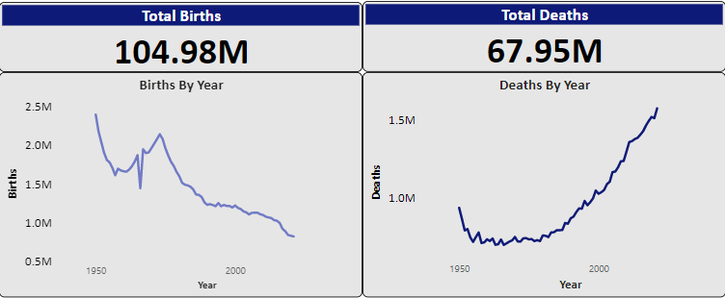
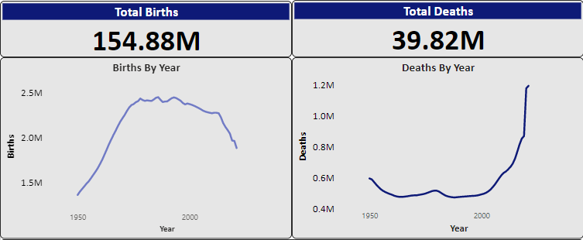
Continuation
China
Mexico
Japan

Slide 14
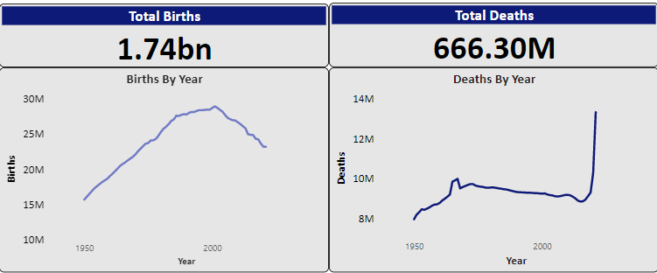
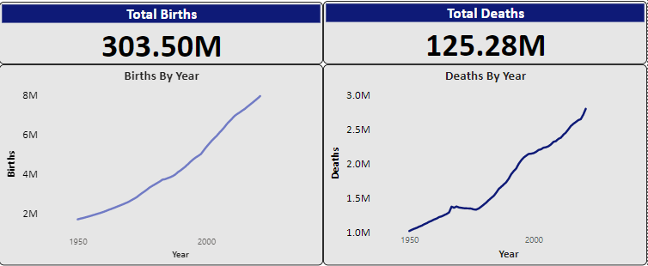
Continuation
India
Nigeria

Slide 15
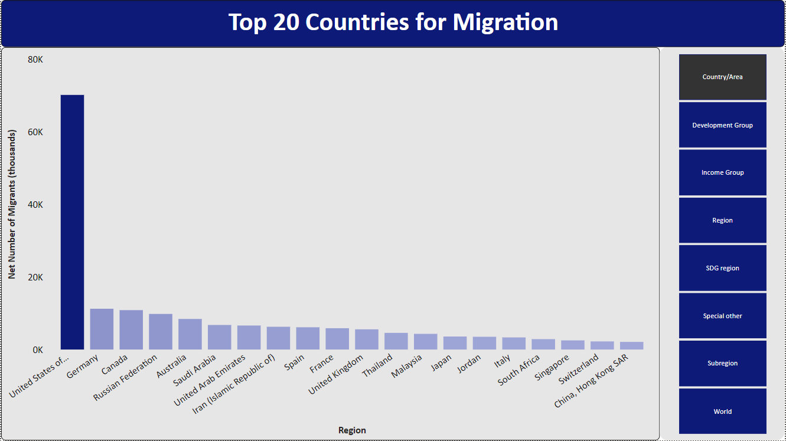
Population is a very important resource that every country must manage well, as too much will stifle the other resources and too little will cause the country to decline.
Values were recorded in positive numbers for immigration and negative numbers for emigration, the difference for every thousandth migrant is all that’s displayed
Canada sees as much as over 10 million immigrants more than their emigrants.

Slide 16
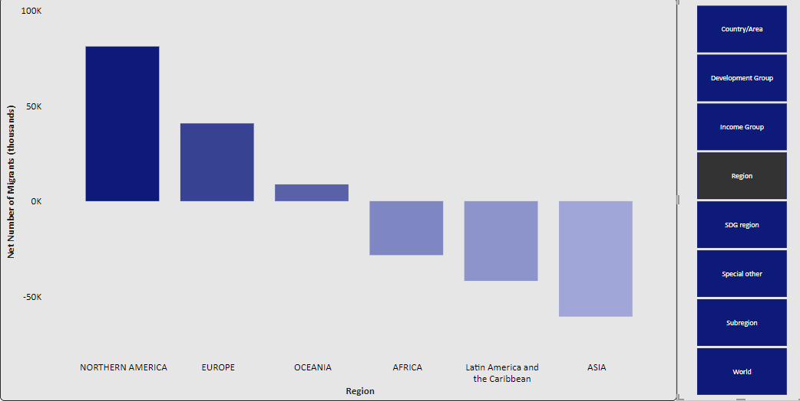
Region
North America, Europe and Oceania have more people migrating to them and the other regions having more people migrate from them

Slide 17
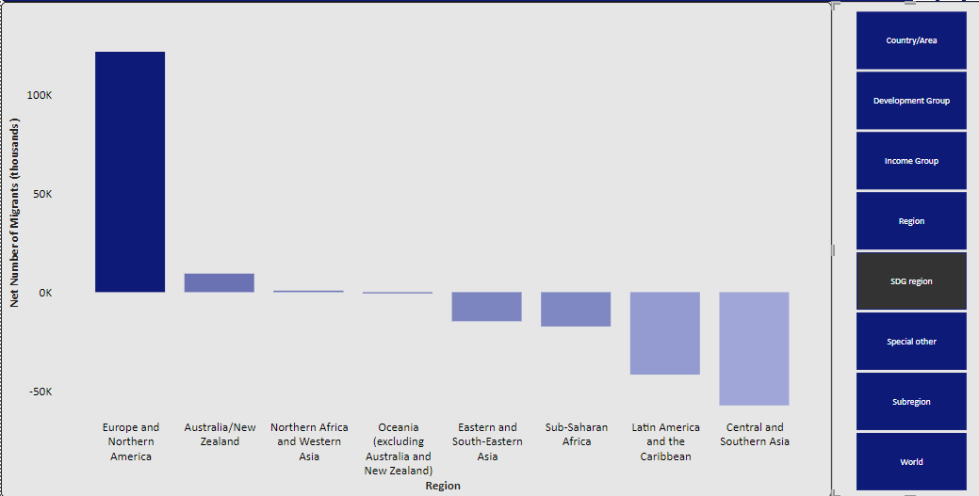
SDG Region
Europe and Northern America have the most Immigrants, while Central and Southern Asia have the most Emigrants

Slide 18
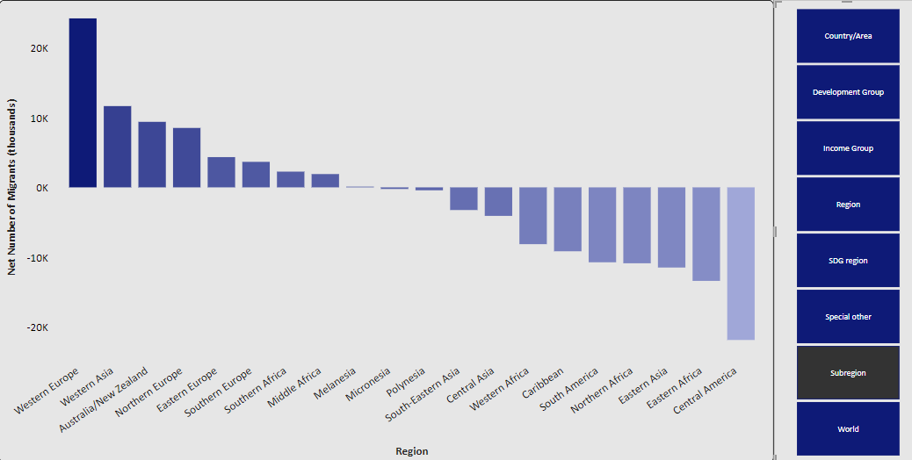
Subregion
It can be seen from the graph that the number of immigrants is inversely proportional to the number of emigrants.

Slide 19
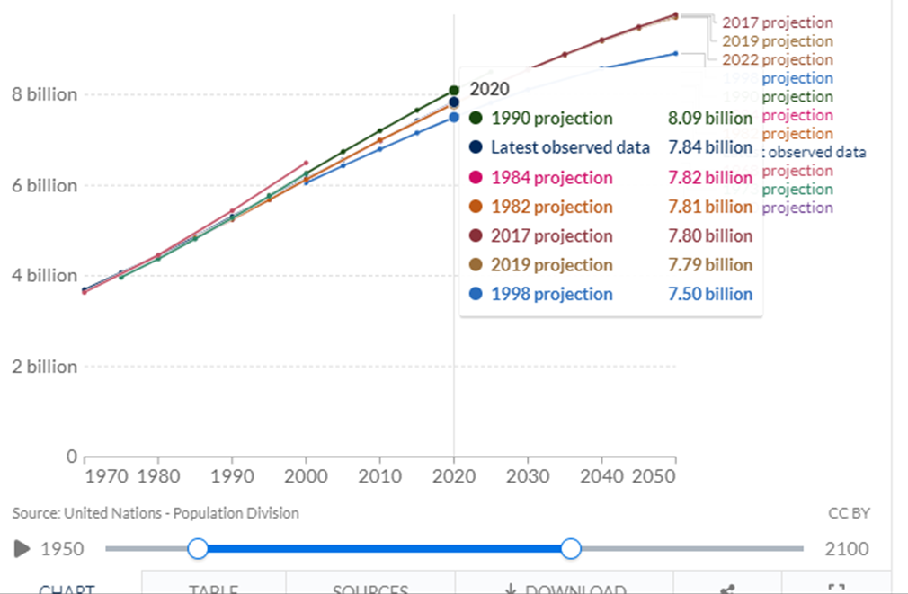
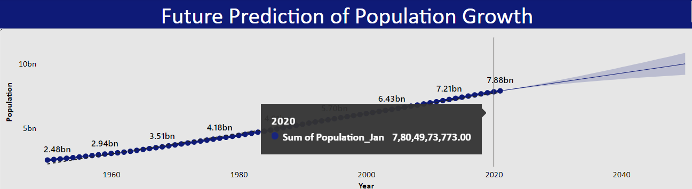
Why Prediction?
Previous
Ours
7.50 – 8.09 billions
7.79 billion for 2019
7.8 billion 2022

Slide 20
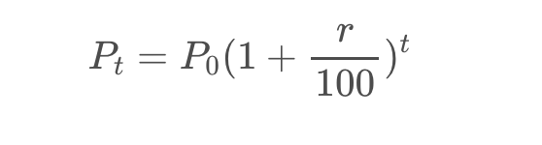
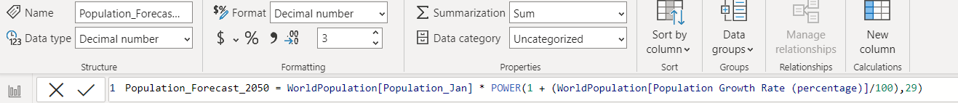
Calculations
Population Projection
t: Number of years
Pt: Population after t years
P0: Population at the start
r: Growth annual rate (in %)
[4]

Slide 21
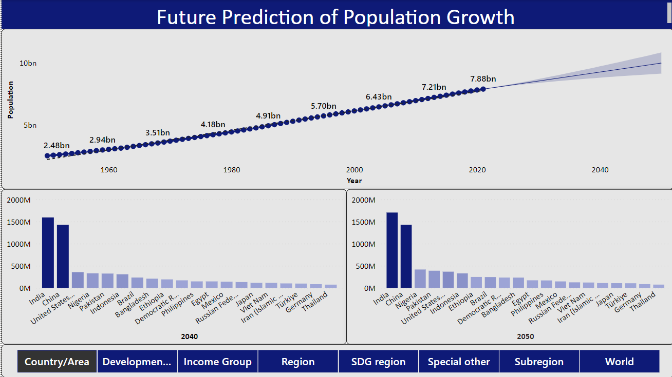
India will surpass China in the year 2023 and maintain the position until 2050

Slide 22
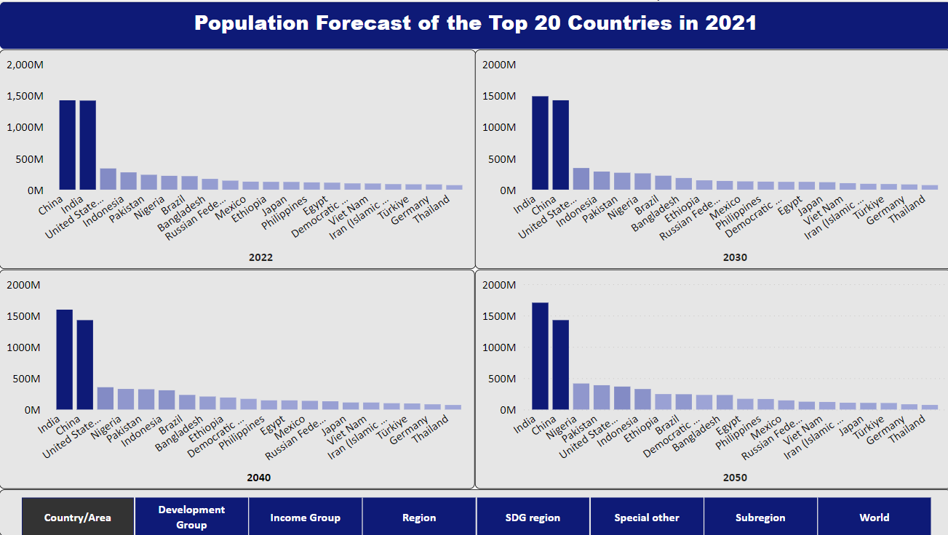
Countries in Middle Africa, Central America and West Africa seeing a considerable rise in their population in 30 years.
Eastern Europe will drop by a couple of places
Asia will remain as the region with the highest population rate

Slide 23
Key Conclusions
Population growth is primarily caused by declining levels of mortality, increased levels of life expectancy at birth, and in part by the increasing annual birth rates.
More than 70% of the world population live in the 20 most populous countries of the world.
In November 2022, the global population exceeded the 8 billion mark and projections suggest that it could grow to around 8.5 billion in 2030 and 9.7 billion in 2050.
The COVID-19 pandemic has impacted all components of population change, including fertility, mortality, and migration.
India will overtake China to become the world’s most populous country in 2023.
Because of the advantage in life expectancy, females outnumber males. On a global scale women comprised about 55% of persons aged 60 and over in 2021.
The populations of some of the top 20 countries are projected to decrease in between 2022 and 2050, owing to sustained lowering levels of births and, in some cases, elevated rates of emigration.
COVID- 19 pandemic dropped the life expectancy from around 73 in 2019 to 71 in 2021, but it is set to rise to 77 years between 2045 and 2050.
“In 2020, the global population growth rate fell under 1 per cent per year for the first time since 1950. The world’s population is projected to reach a peak of around 10.4 billion people during the 2080s and to remain at that level until 2100” [1].

Slide 24
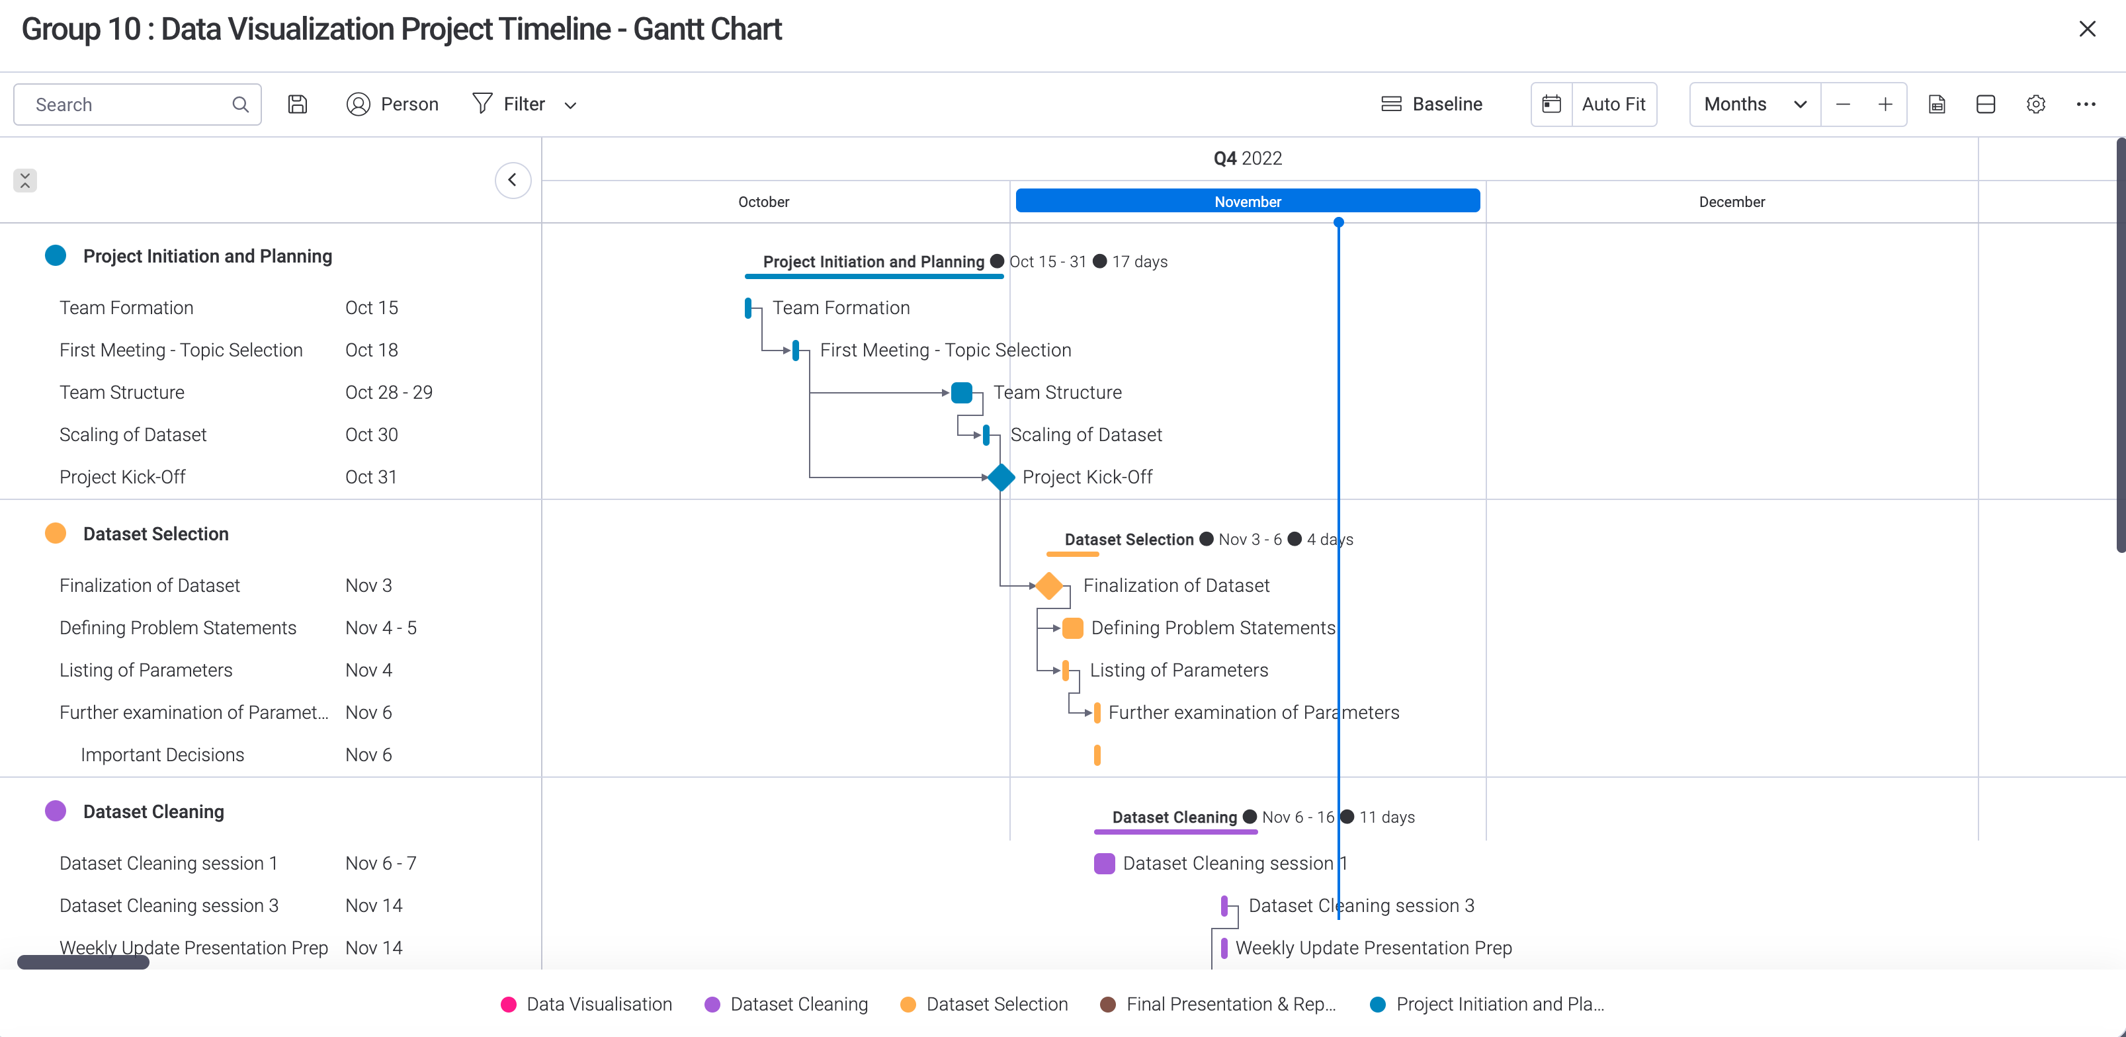
Project Timeline

Slide 25
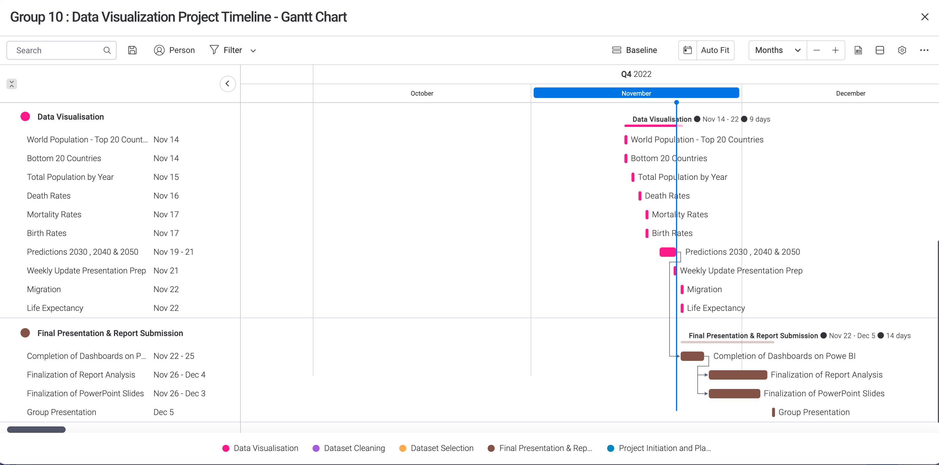
Project Timeline

Slide 26

Management Dashboard

Slide 27
References
United Nations Department of Economic and Social Affairs, Population Division (2022) World Population Prospects 2022, World population prospects - population division. United Nations. Available at: https://population.un.org/wpp/Download/Standard/MostUsed/ (Accessed: November 3, 2022).
The Economic Times (2022) World Population Day 2022: From China to Vatican City, significance of the day in numbers, The Economic Times. ET Magazine. Available at: https://economictimes.indiatimes.com/magazines/panache/world-population-day-2022-from-china-to-vatican-city-significance-of-the-day-in-numbers/articleshow/92799370.cms (Accessed: December 2, 2022).
Worldometer (2022) Current world population. Worldometer. Available at: https://www.worldometers.info/world-population/ (Accessed: November 16, 2022).
Harits, F. (2022, September 29). World population - past, present, and future. Kaggle. Retrieved December 4, 2022, from https://www.kaggle.com/code/harits/world-population-past-present-and-future

Slide 28

Questions

